Slide 1

your business
2
“Take your business in a new direction”

Slide 2
About our company

Slide 3

Background
Northeast Web Design
Need for a separate web design branch developed with growing demand
Evolutionary extension of Northeast Computer Services, an established IT firm since 2001
Currently, we have about 35 active clients
Our Personal Approach:
Northeast Web Design is a small company located in the quaint town of Hebron, CT that believes strongly in highly personal service.
All of our development is done in house- we do not outsource.
Northeast Web Design works with all types of clients, from small businesses to large scale enterprises.
Our high referral and high retention rates allow our business to succeed.
“
We offer more than just web development. We create a marketing tool, not just a marketing piece.
”

Slide 4
Philosophy
Our Fundamental Belief:
  Every business has the potential for success
Our Goal:
  Improve the Functionality of a Business By:
      Developing a marketing tool connecting directly to their clients
      Empowering clients to be industry thought leaders with state of the art systems
      Educating clients to be able to control their own web resources
Our Commitment:
  Northeast Web Design proudly stands by our work
  Our accomplishments achieved by:
    Listening to our clients
    Adhering to deadlines
    Providing affordable solutions
  Focus on strong work ethic and implementation of best web practices
  Belief that there is always opportunity to learn and grow through:
    Creative diversity of our client projects
    Consistent research of rapidly evolving technologies

Slide 5
Building on our Framework

Slide 6
Old School Web Design

Slide 7
New Web Development

Slide 8
Advantages

Slide 9
Added Value

Slide 10
Best Practices

Slide 11

W3C Industry Standards
The World Wide Web Consortium (W3C)
  an international consortium that develops Web standards called W3C Recommendations
    Aimed at helping the Web to reach its full potential
    Through “Web interoperability”- requires web technologies to be compatible with one another and allow any hardware or software to access the Web
    W3C seeks to avoid Web fragmentation

Slide 12
Example Websites

Slide 13
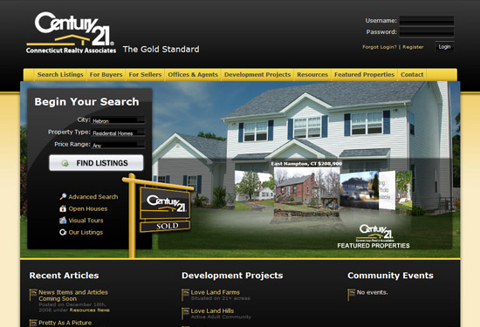
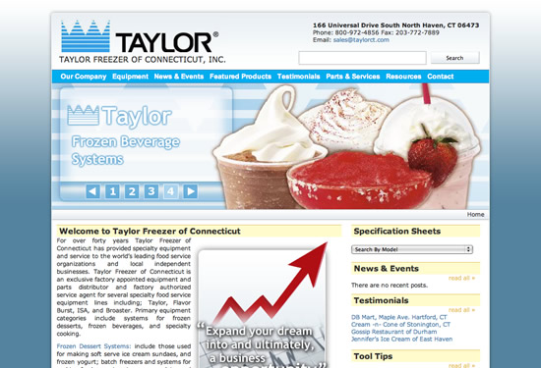
Previous Work
Century 21 Connecticut Realty
Taylor Freezer of Connecticut
Dynamically maintained over 30,000 listed properties as well as feature company and agent listings
Upgraded AJAX based IDX interface, content management system and blogging components for thought leadership resources
complete search engine optimization, Google Pay Per Click campaigns and additional internet marketing strategies
a web site that had a visual appeal that featured a multitude of products
profit calculators for different products and yields
search engine optimization and internet marketing strategies have placed Taylor Freezers of Connecticut on the first page (if not 1st or 2nd organic ranking) on most keyword searches within Connecticut on Google

Slide 14
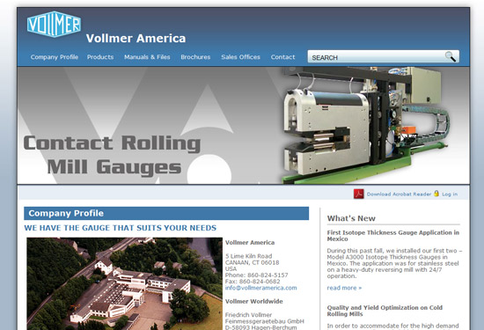
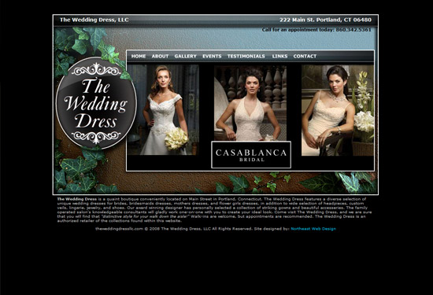
Previous Work
Vollmer America
The Wedding Dress LLC
content management system allowing organization of current pages
simple means of adding and archiving newsletter articles, news and events, and new products dynamically
Additional features included flash development, custom search and 404 error pages, and password protected directories for securing sensitive company documents
an engaging user-friendly site in a flash environment
a seamless flash production and still yield great organic keyword rankings
a simple to maintain XML component that dynamically loads an unlimited number of dresses into flash player
Search Engine Optimization, XHTML & CSS validation and initial Internet Marketing Strategy have landed the first page organic listings in Google

Slide 15
Client Testimonial
Larry Palmer, Century 21 Real Estate:
  “We have received 263 Internet leads across 3 offices in 4 mos…This is the first time since we got the ability to track our lead sources that our company web site is producing more hits then Realtor.com. This is due the redesign last year and very much improved IDX search function.”
Michael Meakem, President Center for Financial Training:
  “I switched our company web design work to Northeast Web Design more than five years ago. I could not be happier with their work. From the design work, to the database interface with our proprietary software the lists all of our offerings, to the search engine optimization, to our Google pay per click campaign. The data interface saves a tremendous amount of time and money keeping the web site current. The search engine optimization and pay per click work is invaluable in reaching new customers. The Northeast Web Design staff is extremely responsive and knowledgeable. I would highly recommend their services to businesses of all sizes.”

Slide 16
Contact Info
Northeast Web Design offers continual support even after all web development is complete.
Our maintenance plan is designed to keep the website running in a secure and optimal condition.

